Slide 1

Big Data Infrastructure
CS 489/698 Big Data Infrastructure (Winter 2016)
Week 8: Data Mining (1/4)
March 1, 2016
Jimmy Lin
David R. Cheriton School of Computer Science
University of Waterloo
These slides are available at http://lintool.github.io/bigdata-2016w/
This work is licensed under a Creative Commons Attribution-Noncommercial-Share Alike 3.0 United States See http://creativecommons.org/licenses/by-nc-sa/3.0/us/ for details

Slide 2
Structure of the Course
Analyzing Text
Analyzing Relational Data
Analyzing Graphs
Data Mining
“Core” framework features and algorithm design

Slide 3
Supervised Machine Learning
The generic problem of function induction given sample instances of input and output
Focus today
Classification: output draws from finite discrete labels
Regression: output is a continuous value
This is not meant to be an exhaustive treatment of machine learning!

Slide 4

Classification
Source: Wikipedia (Sorting)

Slide 5
Applications
Spam detection
Sentiment analysis
Content (e.g., genre) classification
Link prediction
Document ranking
Object recognition
Fraud detection
And much much more!

Slide 6


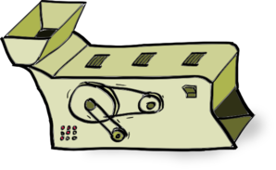
Supervised Machine Learning
training
testing/deployment
training data
Model
?
Machine Learning Algorithm

Slide 7
Feature Representations
Who comes up with the features?
How?
Objects are represented in terms of features:
“Dense” features: sender IP, timestamp, # of recipients, length of message, etc.
“Sparse” features: contains the term “viagra” in message, contains “URGENT” in subject, etc.

Slide 8
Applications
Spam detection
Sentiment analysis
Content (e.g., genre) classification
Link prediction
Document ranking
Object recognition
Fraud detection
And much much more!
Features are highly application-specific!

Slide 9
Components of a ML Solution
Data
logistic regression, naïve Bayes, SVM, random forests, perceptrons, neural network, etc.
Features
Model
gradient descent, stochastic gradient descent, L-BFGS, etc.
Optimization
What “matters” the most?

Slide 10
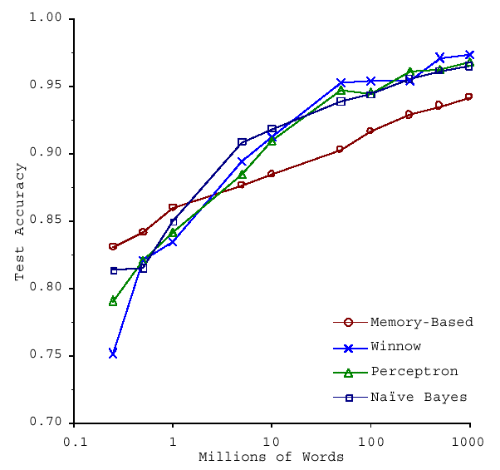
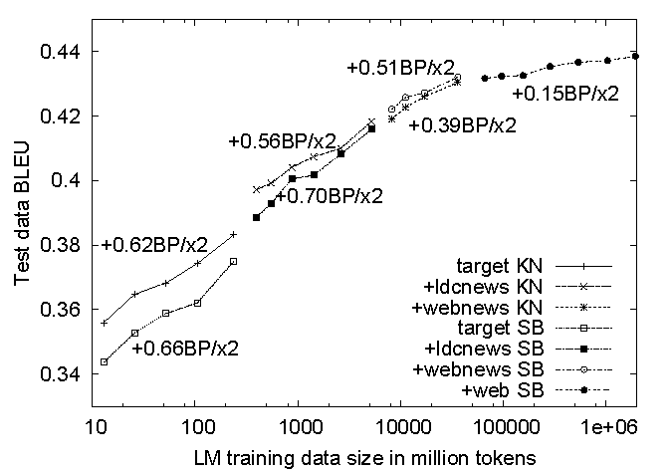
No data like more data!
s/knowledge/data/g;
(Banko and Brill, ACL 2001)
(Brants et al., EMNLP 2007)

Slide 11
Limits of Supervised Classification?
Why is this a big data problem?
Isn’t gathering labels a serious bottleneck?
Solution: crowdsourcing
Solution: user behavior logs
Learning to rank
Computational advertising
Link recommendation
The virtuous cycle of data-driven products

Slide 12
Supervised Binary Classification
Restrict output label to be binary
Yes/No
1/0
Binary classifiers form a primitive building block for multi-class problems
One vs. rest classifier ensembles
Classifier cascades

Slide 13
The Task
label
Given
(sparse) feature vector
Induce
Such that loss is minimized
loss function
Typically, consider functions of a parametric form:
model parameters

Slide 14
Key insight: machine learning as an optimization problem!
(closed form solutions generally not possible)

Slide 15
Gradient Descent: Preliminaries
Rewrite:
Compute gradient:
“Points” to fastest increasing “direction”
So, at any point:
*
* caveats

Slide 16
Gradient Descent: Iterative Update
Start at an arbitrary point, iteratively update:
We have:
Lots of details:
Figuring out the step size
Getting stuck in local minima
Convergence rate
…

Slide 17
Gradient Descent
Repeat until convergence:

Slide 18
Intuition behind the math…
New weights
Old weights
Update based on gradient

Slide 19
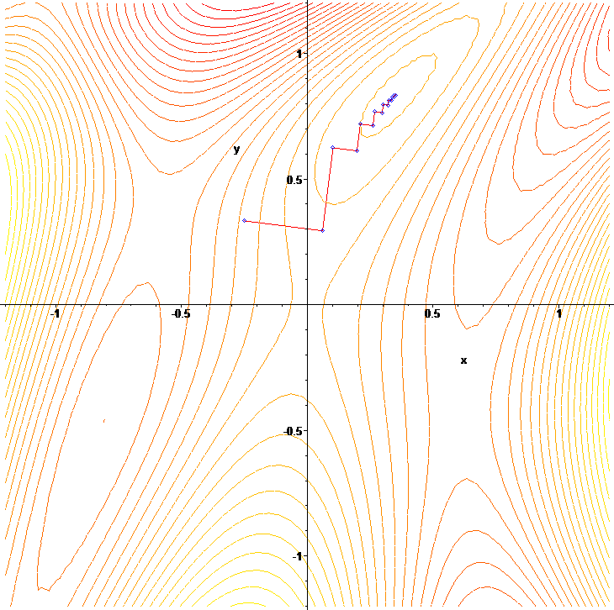
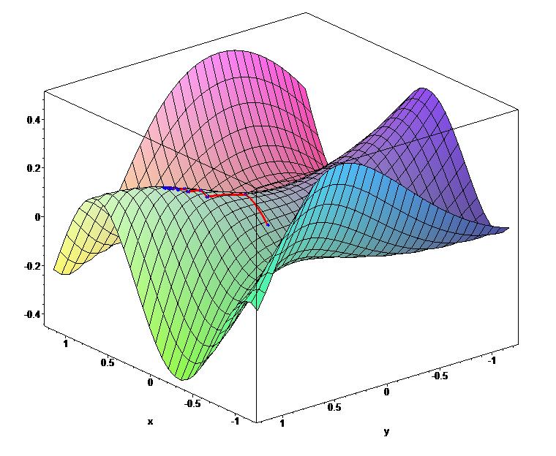

Slide 20

Gradient Descent
Source: Wikipedia (Hills)

Slide 21
Lots More Details…
Gradient descent is a “first order” optimization technique
Often, slow convergence
Conjugate techniques accelerate convergence
Newton and quasi-Newton methods:
Intuition: Taylor expansion
Requires the Hessian (square matrix of second order partial derivatives): impractical to fully compute

Slide 22

Logistic Regression
Source: Wikipedia (Hammer)

Slide 23
Logistic Regression: Preliminaries
Given
Let’s define:
Interpretation:

Slide 24
Relation to the Logistic Function
After some algebra:
The logistic function:

Slide 25
Training an LR Classifier
Maximize the conditional likelihood:
Define the objective in terms of conditional log likelihood:
We know so:
Substituting:

Slide 26
LR Classifier Update Rule
Take the derivative:
General form for update rule:
Final update rule:

Slide 27
Lots more details…
Regularization
Different loss functions
…
Want more details? Take a real machine-learning course!

Slide 28
MapReduce Implementation
mappers
single reducer
compute partial gradient
mapper
mapper
mapper
mapper
reducer
iterate until convergence
update model

Slide 29
Shortcomings
Hadoop is bad at iterative algorithms
High job startup costs
Awkward to retain state across iterations
High sensitivity to skew
Iteration speed bounded by slowest task
Potentially poor cluster utilization
Must shuffle all data to a single reducer
Some possible tradeoffs
Number of iterations vs. complexity of computation per iteration
E.g., L-BFGS: faster convergence, but more to compute

Slide 30
Spark Implementation
val points = spark.textFile(...).map(parsePoint).persist()
var w = // random initial vector
for (i <- 1 to ITERATIONS) {
val gradient = points.map{ p =>
p.x * (1/(1+exp(-p.y*(w dot p.x)))-1)*p.y
}.reduce((a,b) => a+b)
w -= gradient
}
What’s the difference?
compute partial gradient
mapper
mapper
mapper
mapper
reducer
update model

Slide 31
Gradient Descent
Source: Wikipedia (Hills)

Slide 32
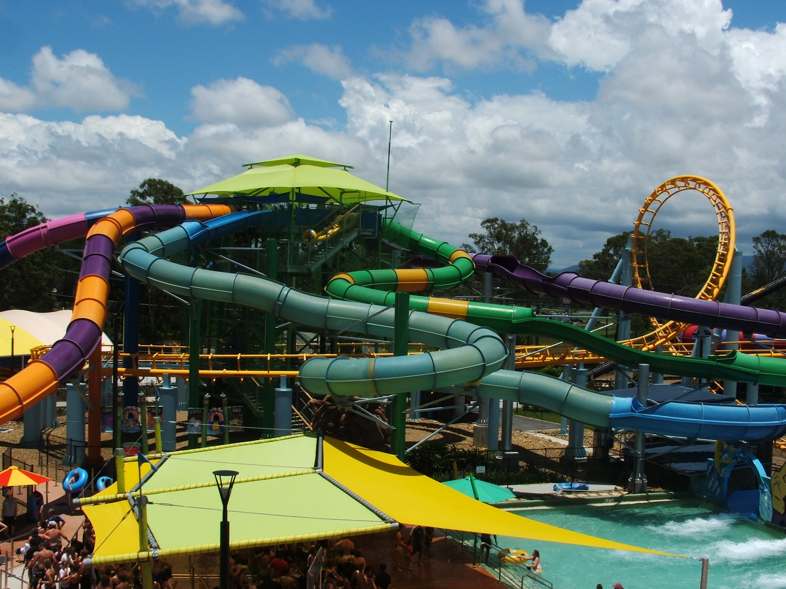
Stochastic Gradient Descent
Source: Wikipedia (Water Slide)

Slide 33
Batch vs. Online
Gradient Descent
“batch” learning: update model after considering all training instances
Stochastic Gradient Descent (SGD)
“online” learning: update model after considering each (randomly-selected) training instance
In practice… just as good!

Slide 34
Practical Notes
Most common implementation:
Randomly shuffle training instances
Stream instances through learner
Single vs. multi-pass approaches
“Mini-batching” as a middle ground between batch and stochastic gradient descent
We’ve solved the iteration problem!
What about the single reducer problem?

Slide 35
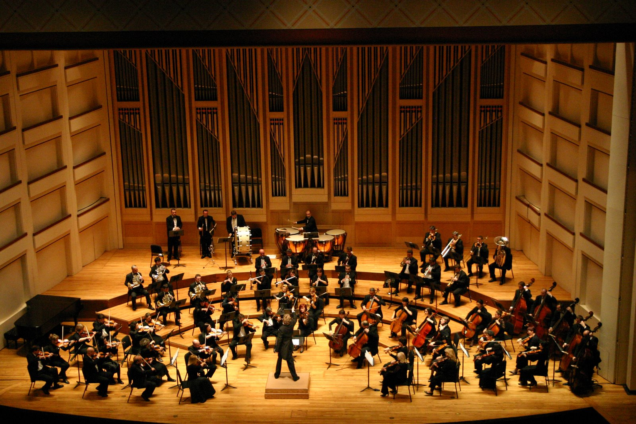
Ensembles
Source: Wikipedia (Orchestra)

Slide 36
Ensemble Learning
Learn multiple models, combine results from different models to make prediction
Why does it work?
If errors uncorrelated, multiple classifiers being wrong is less likely
Reduces the variance component of error
A variety of different techniques:
Majority voting
Simple weighted voting:
Model averaging
…

Slide 37
Practical Notes
Common implementation:
Train classifiers on different input partitions of the data
Embarrassingly parallel!
Contrast with other ensemble techniques, e.g., boosting

Slide 38
MapReduce Implementation
training data
training data
training data
training data
mapper
mapper
mapper
mapper
learner
learner
learner
learner

Slide 39
MapReduce Implementation
training data
training data
training data
training data
mapper
mapper
mapper
mapper
mapper
mapper
learner
learner

Slide 40
What about Spark?
RDD[T]
mapPartitions f: (Iterator[T]) ⇒ Iterator[U]
learner
RDD[U]

Slide 41
MapReduce Implementation: Details
Two possible implementations:
Write model out as “side data”
Emit model as intermediate output

Slide 42
Sentiment Analysis Case Study
Lin and Kolcz, SIGMOD 2012
Binary polarity classification: {positive, negative} sentiment
Independently interesting task
Illustrates end-to-end flow
Use the “emoticon trick” to gather data
Data
Test: 500k positive/500k negative tweets from 9/1/2011
Training: {1m, 10m, 100m} instances from before (50/50 split)
Features: Sliding window byte-4grams
Models:
Logistic regression with SGD (L2 regularization)
Ensembles of various sizes (simple weighted voting)

Slide 43
Diminishing returns…
Ensembles with 10m examples better than 100m single classifier!
“for free”
single classifier
10m ensembles
100m ensembles

Slide 44
Supervised Machine Learning
training
testing/deployment
training data
Model
?
Machine Learning Algorithm

Slide 45
Applied ML in Academia
Download interesting dataset (comes with the problem)
Run baseline model
Train/test
Build better model
Train/test
Does new model beat baseline?
Yes: publish a paper!
No: try again!

Slide 46
Three Commandants of Machine Learning
Thou shalt not mix training and testing data
Thou shalt not mix training and testing data
Thou shalt not mix training and testing data

Slide 47
Training/Testing Splits
Training
Test
What happens if you need more?
Cross-Validation

Slide 48
Training/Testing Splits
Cross-Validation

Slide 49
Training/Testing Splits
Cross-Validation

Slide 50
Training/Testing Splits
Cross-Validation

Slide 51
Training/Testing Splits
Cross-Validation

Slide 52
Training/Testing Splits
Cross-Validation

Slide 53
Applied ML in Academia
Download interesting dataset (comes with the problem)
Run baseline model
Train/test
Build better model
Train/test
Does new model beat baseline?
Yes: publish a paper!
No: try again!

Slide 54
Applied ML in Industry
Formulate the problem (from some vague business goal)
Find the data
Prepare and clean the data
Run data through machine learning library
Train/test on retrospective data
Does the new model beat baseline?
Yes: Run live A/B test
No: try again!
Does the new model work in A/B testing?
Yes: productionize the model
No: try again!
Where’s most of the time spent?

Slide 55
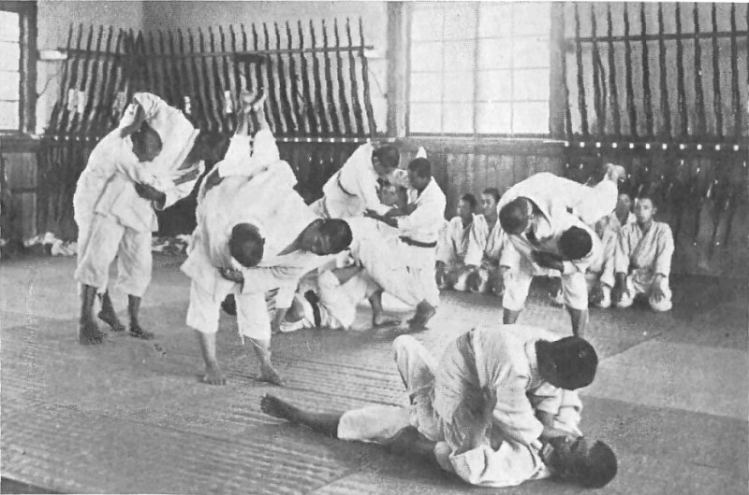
It’s impossible to overstress this: 80% of the work in any data project is in cleaning the data. – DJ Patil “Data Jujitsu”
Source: Wikipedia (Jujitsu)

Slide 56
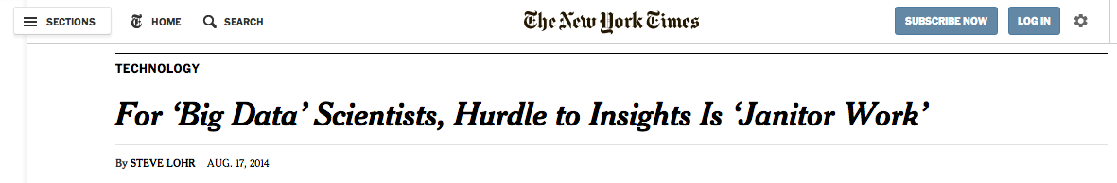
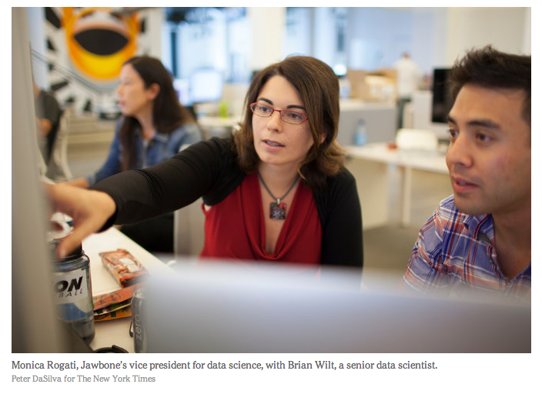

Slide 57
Components of a ML Solution
Data
Features
Model
Optimization
What “matters” the most?

Slide 58

Questions?
Source: Wikipedia (Japanese rock garden)

